Slide 1
Integrated System for Measuring Road Roughness
Talha Alvi
Iven H. Liu
Natnael Alemu
Notes:
© Copyright PresentationGo.com – The free PowerPoint library

Slide 2
www.roadquality.ca

Slide 3
Problem at Hand
Half a million dollars spent annually on road surface surveying
Needs better quantify the problem of road roughness.
This calls for an engineering solution that can save tax payers money
Improves communities of Regina.
www.roadquality.ca
Notes:
© Copyright PresentationGo.com – The free PowerPoint library

Slide 4
Engineering Solution
Designing a modular and cost effective integrated system which can be mounted to any vehicle and collect road profile when driving. Results are to be displayed in a convenient format, accessible by the public.
www.roadquality.ca
Notes:
© Copyright PresentationGo.com – The free PowerPoint library

Slide 5
Design Specification
Be able to measure surface roughness of a pavement
Map out where the data is being collected
Low cost and modular
Provide visual reference of road surface
A streamlined method for processing
Present it in a graphical format
www.roadquality.ca

Slide 6
Division of Labor
Data
Collection
Natnael
Data Transmission
Iven
Data Analysis
Talha

Slide 7
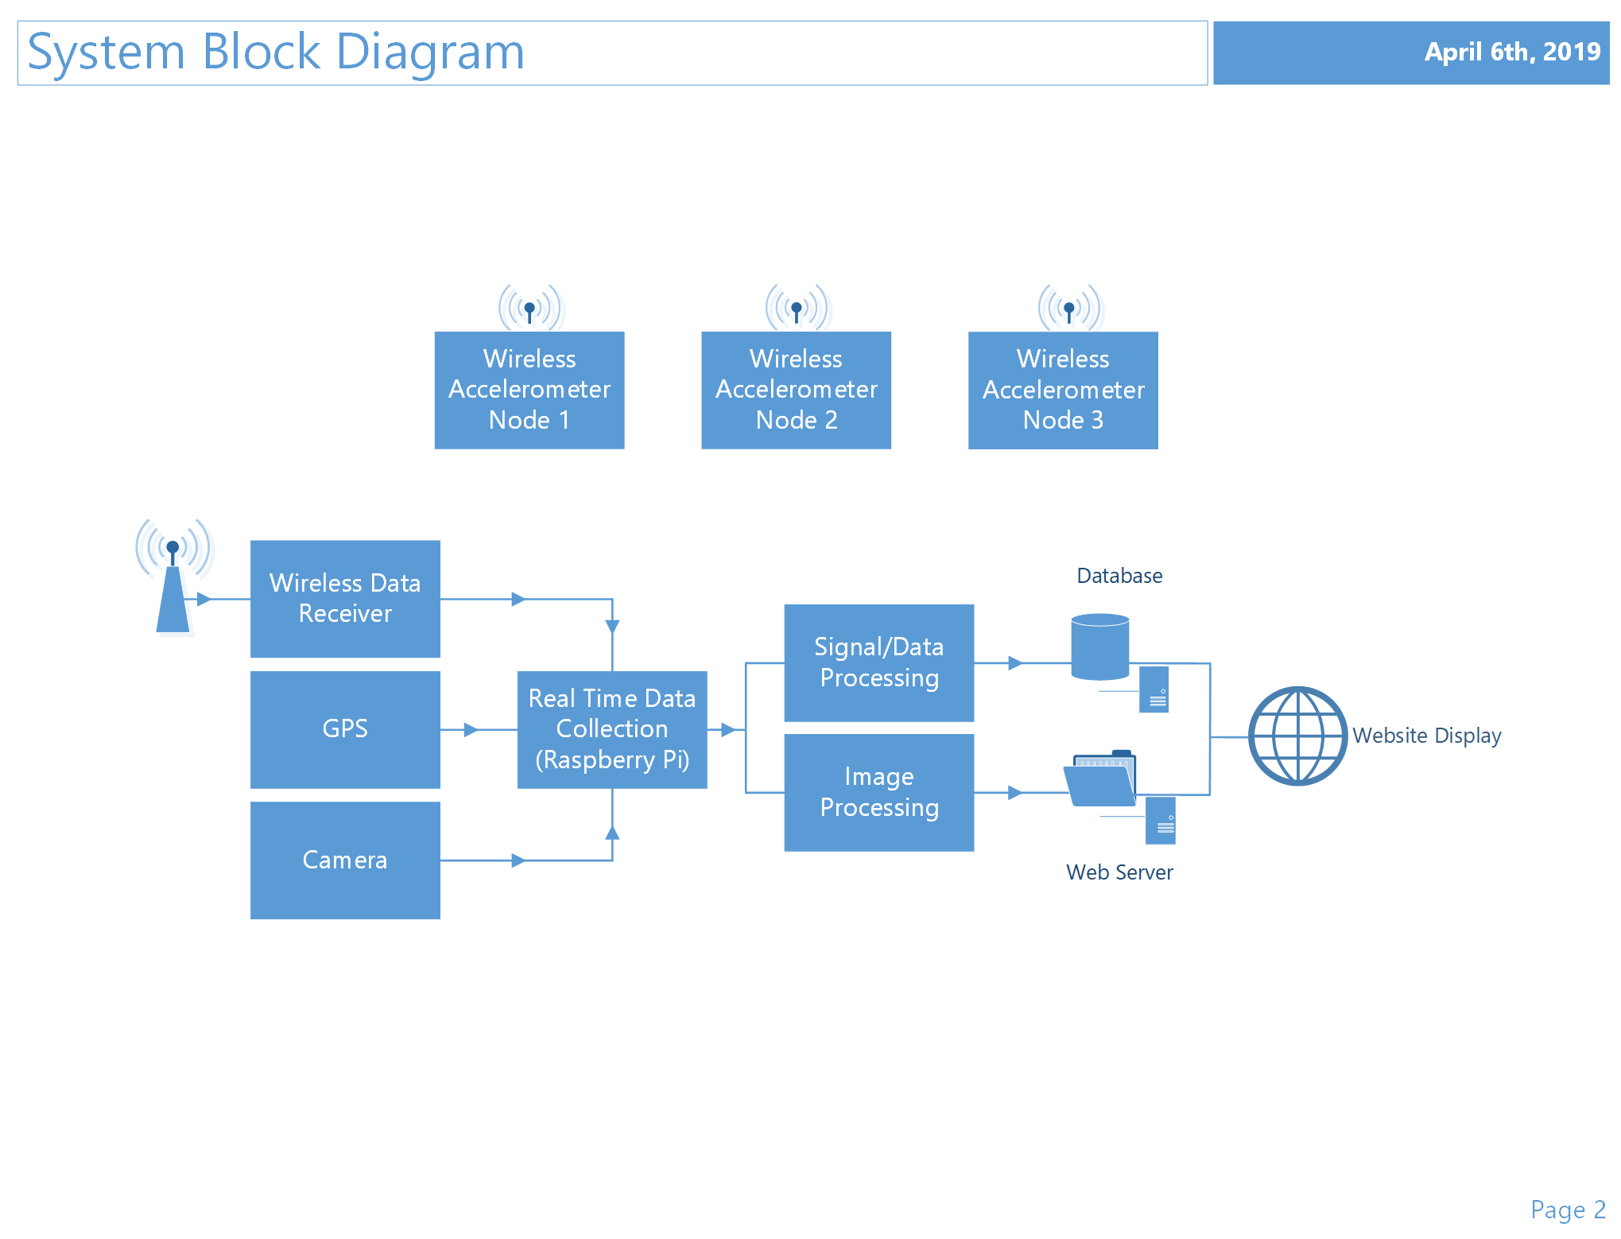
System Level Block Diagram
www.roadquality.ca

Slide 8
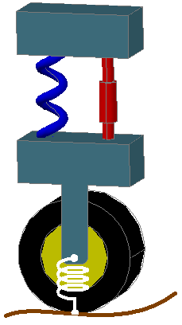
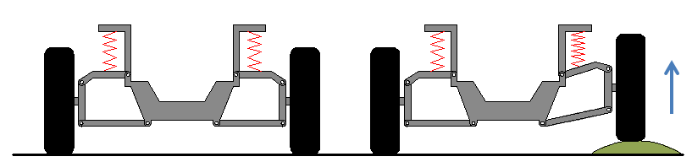
Data Collection
Wheel traveling over a bump
Single wheel weight distribution
www.roadquality.ca

Slide 9
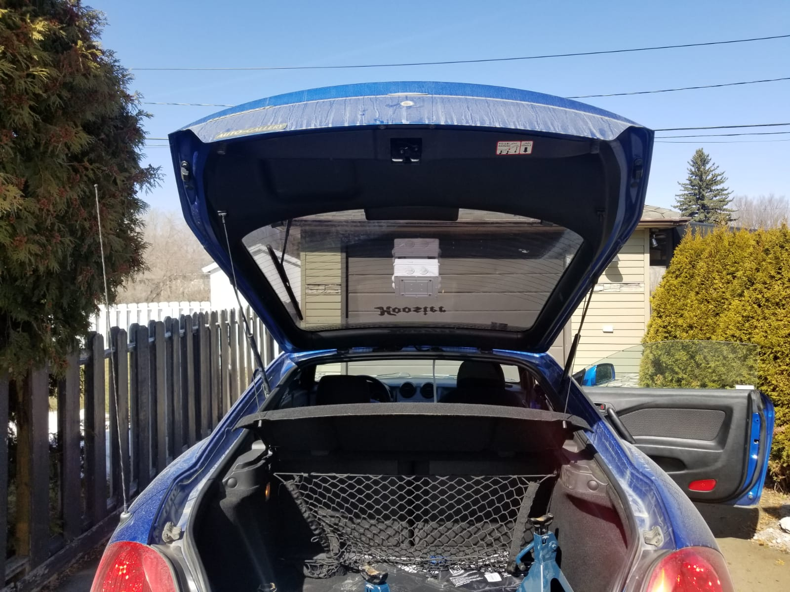
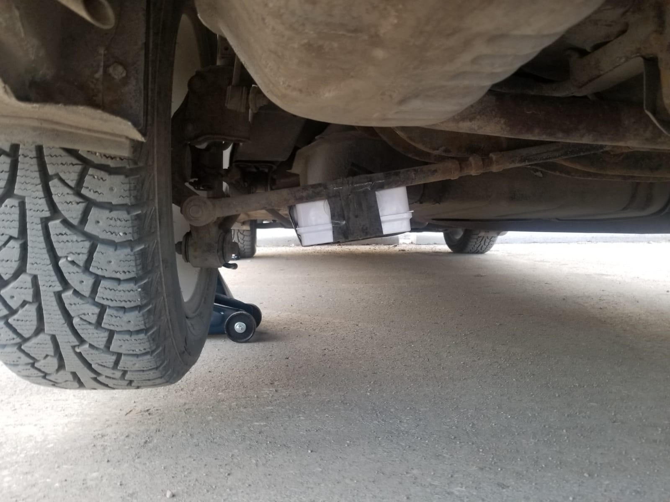
Unsprung Node
Sprung Node
www.roadquality.ca

Slide 10
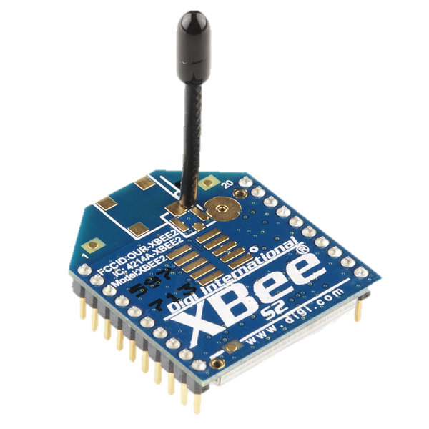
Data Transmission
Xbee Wireless Transmission
Cost effective
Lower power consumption
Mesh network
IEEE 802.15.4
www.roadquality.ca

Slide 11
Data Analysis
www.roadquality.ca

Slide 12
Image Processing
www.roadquality.ca

Slide 13

Video !

Slide 15
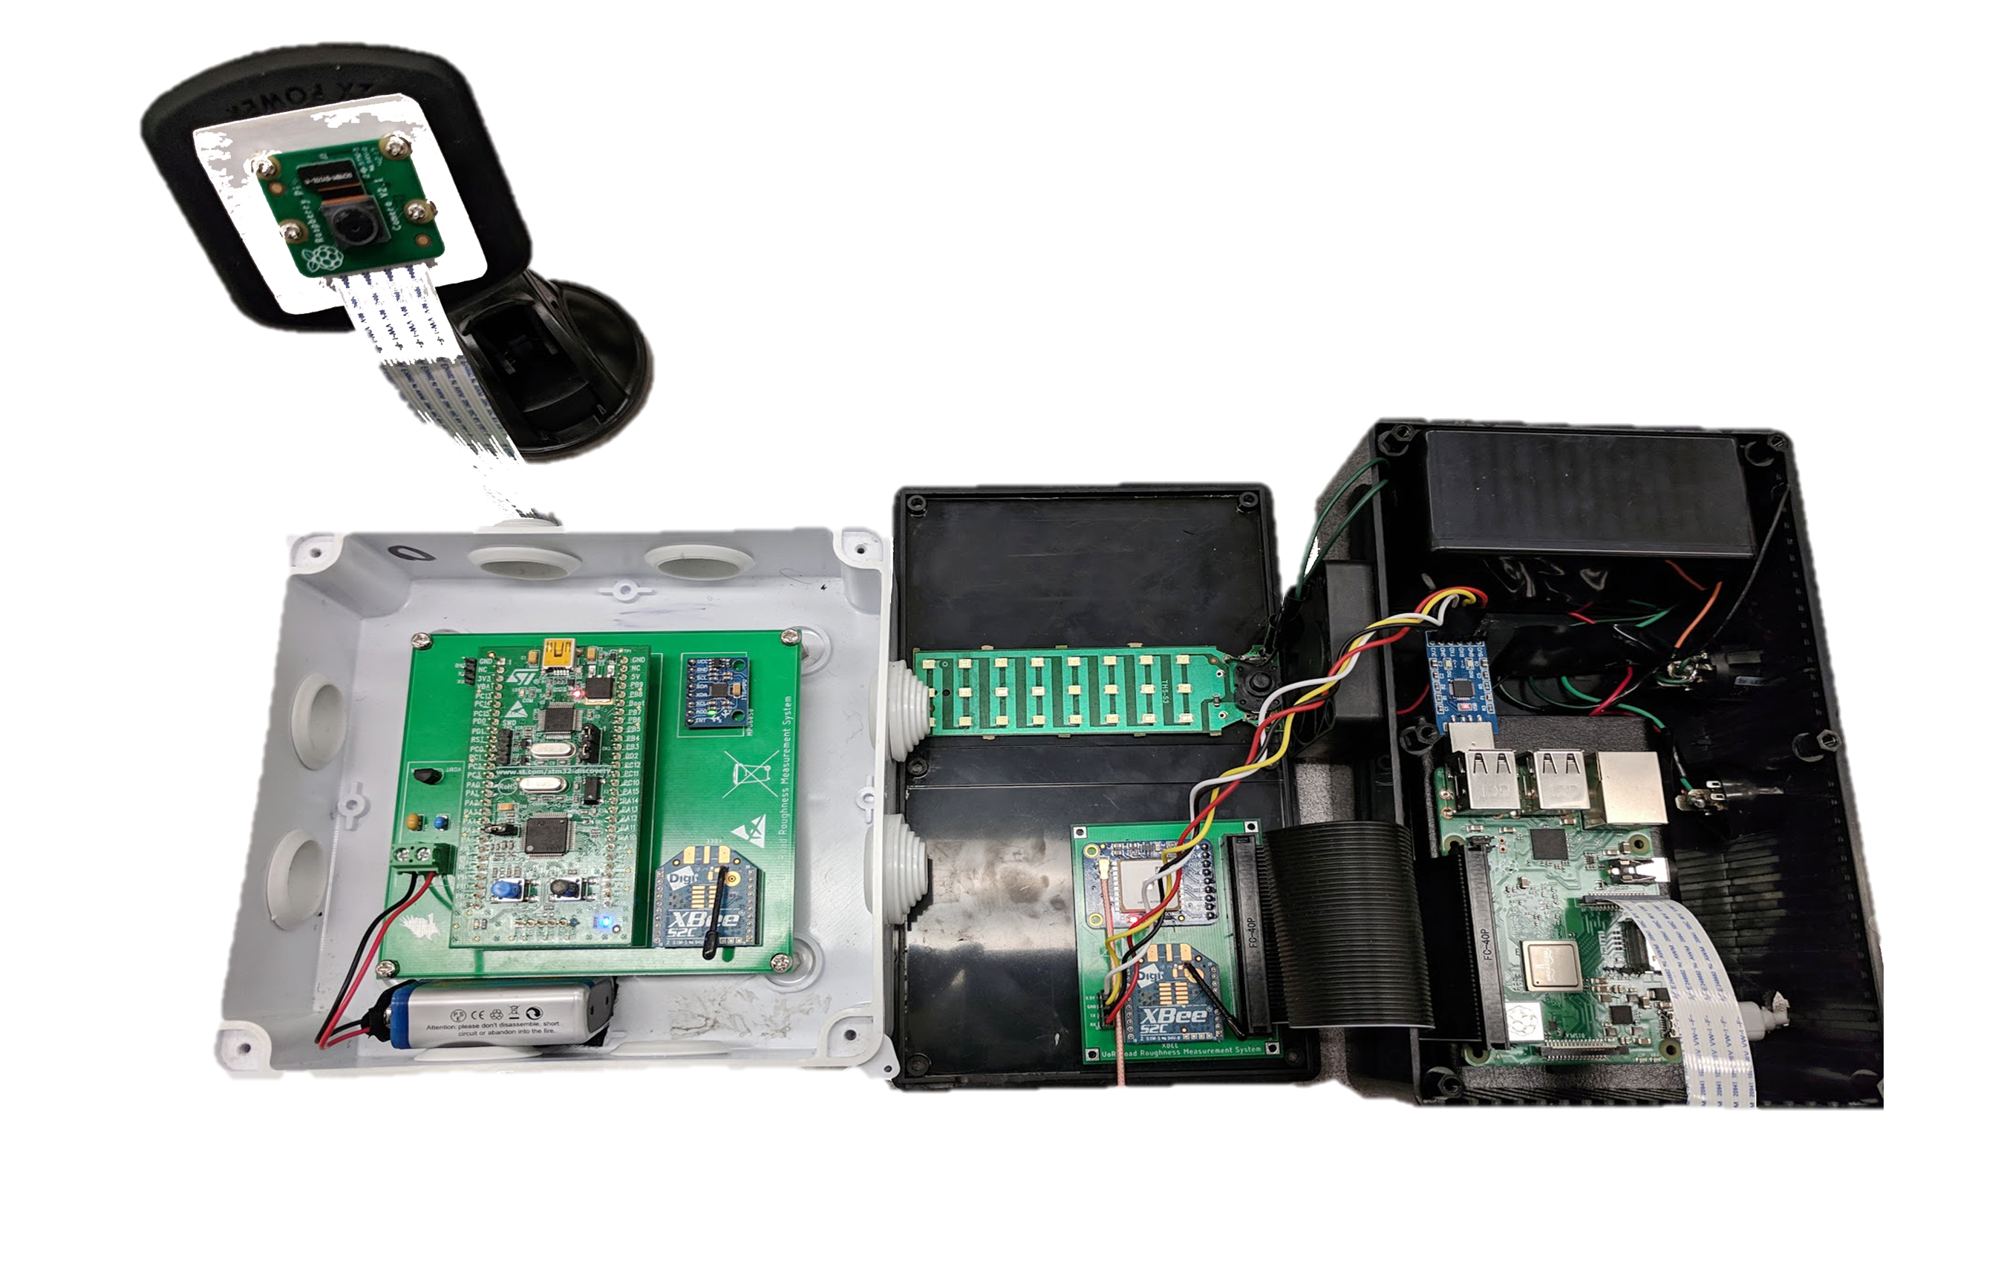
System Prototype
www.roadquality.ca

Slide 16
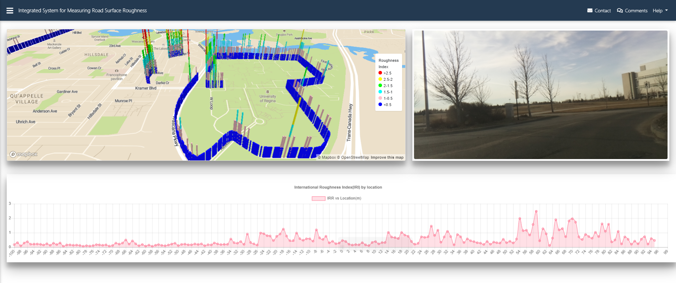
Website Display
www.roadquality.ca

Slide 17
Challenges
Xbee bootloader bypass
Weather conditions
Data organizations
Information loss
www.roadquality.ca

Slide 18
Schedule and Cost Management
www.roadquality.ca

Slide 19
Impact
Social
Saving Tax Money
Environmental
Asphalt
Economical
Saving Tax Money
Preventative Maintenance
Less damage on vehicles
www.roadquality.ca

Slide 20
Design Improvements
Mounting device
GPS
www.roadquality.ca

Slide 21
Future Plans
Incentive plan
Add-on: Pavement cost analysis
www.roadquality.ca

Slide 22
Thank you! Questions and Comments?

